Slide 1

Skill Development Project 1: Agriculture Products Rural Management System
Team Members:
2200033178 K Manish
2200032955 Manish Raj
2200030250 Sekuri Srinivas

Slide 2
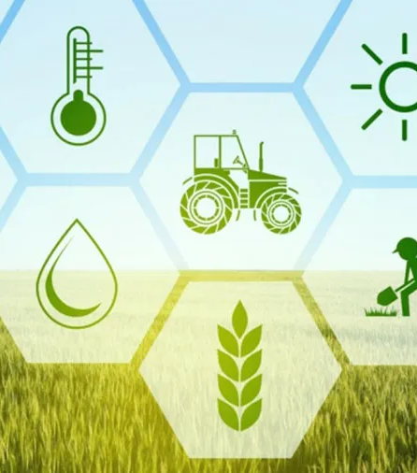
Introduction
Introduction to AgriConnect Hub
Welcome to the presentation on "Agricultural Products Rural Entrepreneurship Management System: AgriConnect Hub."
In today's fast-paced world, connecting agricultural products with rural entrepreneurship is crucial for sustainable economic growth and community development.
Significance of AgriConnect Hub
AgriConnect Hub serves as a digital platform designed to bridge the gap between farmers, entrepreneurs, and consumers.
It addresses the challenges faced by rural communities in marketing agricultural products and establishing successful entrepreneurial ventures.
Why AgriConnect Hub Matters
Empowering Farmers: AgriConnect Hub empowers farmers by providing them with a direct channel to showcase their products and reach a wider market.
Fostering Entrepreneurship: The platform encourages rural entrepreneurship, enabling individuals to create value-added products and services.
Enhancing Economic Growth: By promoting local products and businesses, AgriConnect Hub contributes to the economic growth of rural areas.

Slide 3
Our Vision
Our vision is to create a sustainable ecosystem where agricultural products and rural entrepreneurship thrive in harmony.
AgriConnect Hub aims to create a positive impact on both farmers' livelihoods and rural economies.

Slide 4
Project Overview
AgriConnect Hub: Project Overview
AgriConnect Hub is a comprehensive Agricultural Products Rural Entrepreneurship Management System developed using Python Django.
It serves as an innovative solution to bridge the gap between agricultural producers and rural entrepreneurs.
Key Features and Functionalities
Product Listing: Farmers can showcase their products with detailed information, images, and pricing.
Order Management: Entrepreneurs can place orders directly, promoting local produce.
Payment Processing: Secure online payment options for seamless transactions.
User Authentication: Role-based access for farmers, entrepreneurs, and administrators.
Dashboard: Interactive dashboards for users to track orders and sales.
Community Interaction: Forums and communication tools to foster collaboration and knowledge sharing.

Slide 5
Project Overview
Advantages of AgriConnect Hub
Accessibility: Farmers can reach a broader audience, breaking geographical barriers.
Empowerment: Entrepreneurs can source high-quality local products for value-added ventures.
Market Expansion: Rural communities can access a diverse range of agricultural products.
Sustainability: Promotes sustainable practices by encouraging local consumption.
Realizing Rural Entrepreneurship
AgriConnect Hub acts as a catalyst for rural entrepreneurship, nurturing innovation and economic growth in rural areas.
By facilitating connections between farmers and entrepreneurs, the platform nurtures collaboration and drives positive change.

Slide 6
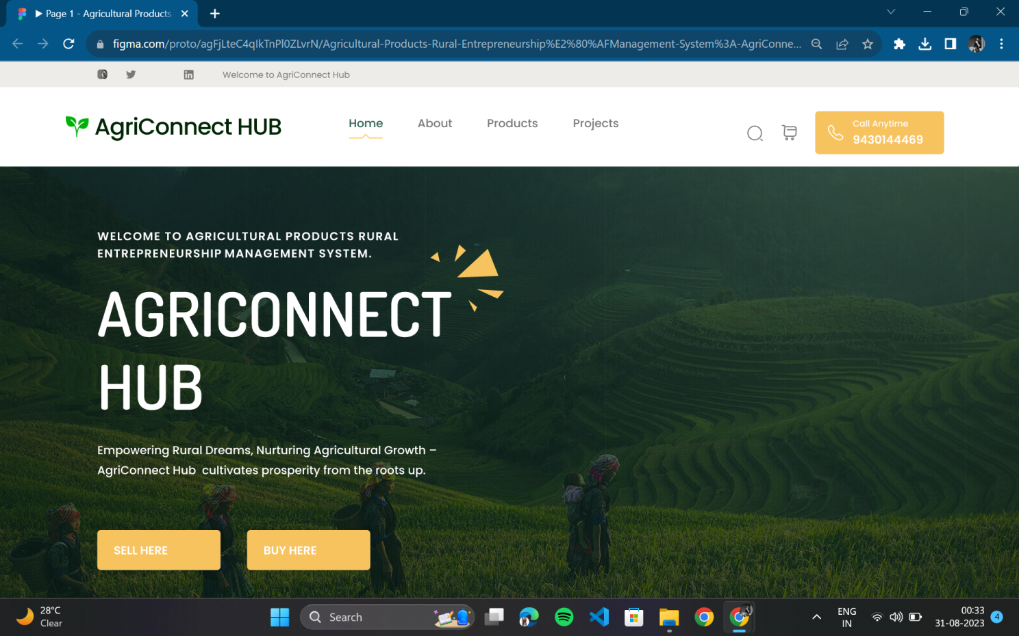
Prototype
This is not the final structure. Just a rough outline of what we are working towards. We will tweak and refine the system along the way as inspiration strikes us.
Landing Home Page

Slide 7
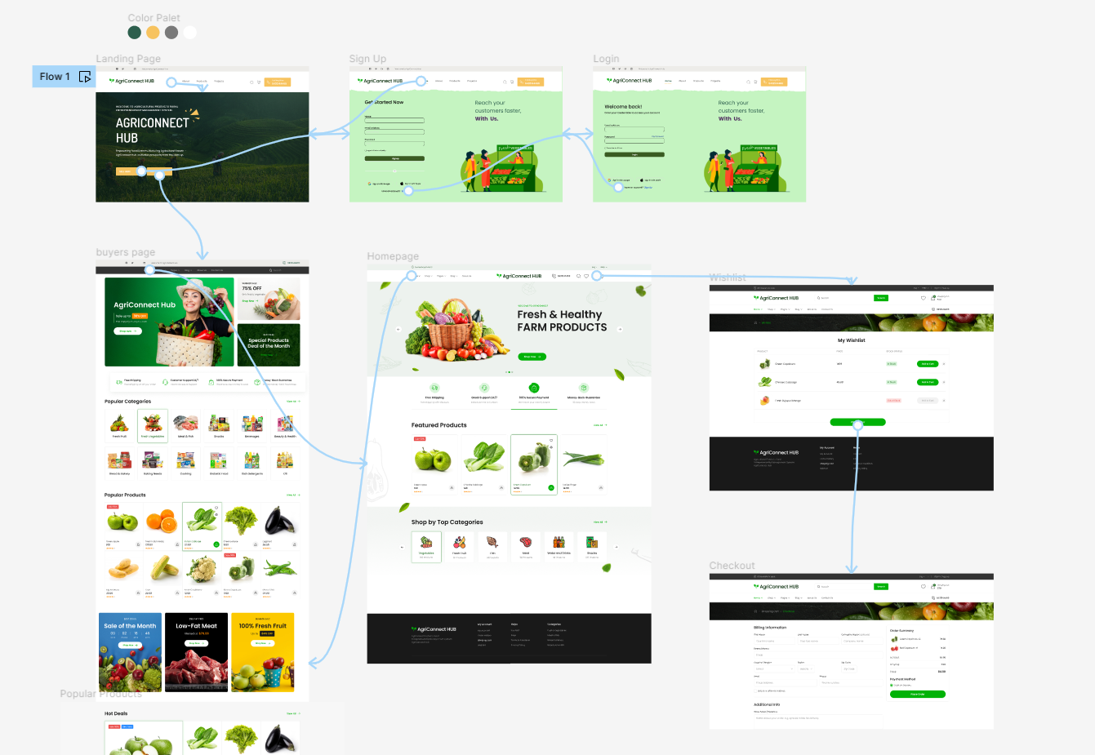
Prototype
Website Flow
CLICK TO VIEW THE WORKING MODEL OF PROTOTYPE

Slide 8
Links
Click to view GitHub Project Link Click to view LinkdIn Article

Slide 9
Technology Stack
Main Framework: Python Django
Database: PostgreSQL
Frontend: HTML, CSS, JavaScript
Authentication: Django Auth
Payment: Payment Gateways
Deployment: AWS
Version Control: Git
Enhancements: Additional Libraries

Slide 10
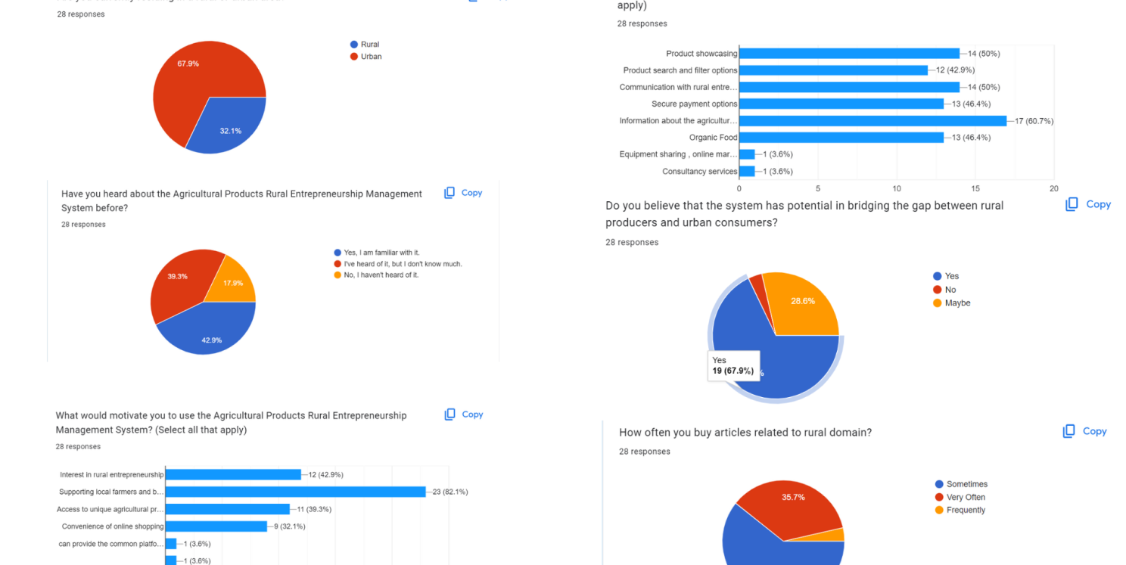
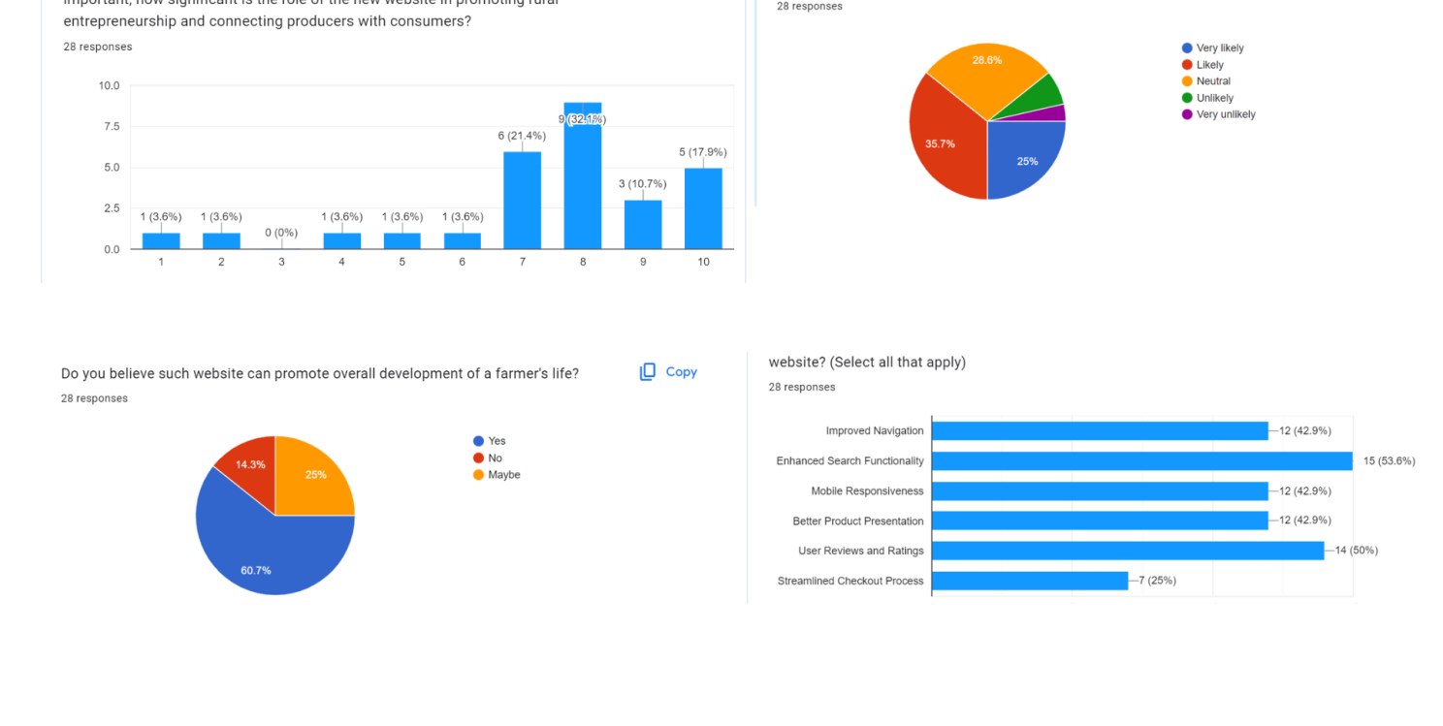
Survey
Why Conduct User Feedback Surveys?
User-Centric Improvement: Surveys provide insights directly from users, enabling us to tailor AgriConnect Hub to your needs.
Identifying Gaps: Surveys help identify areas where the platform can be enhanced for better user satisfaction.
Data-Driven Decisions: Feedback guides our decisions, ensuring we focus on features that matter most.

Slide 11
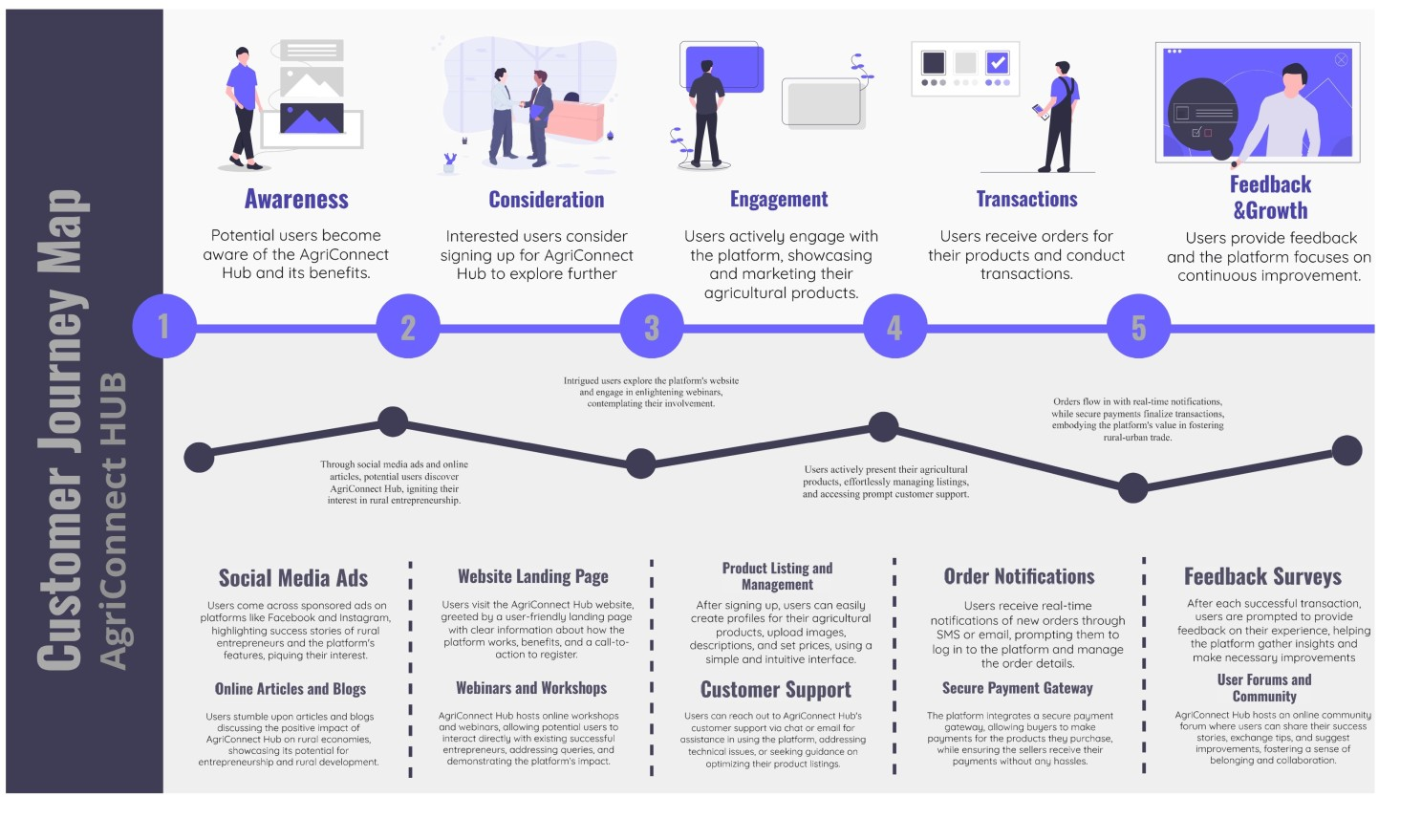
Customer Journey Map
Key Touchpoints and Emotions
We've identified critical touchpoints where user emotions and interactions are most impactful.
Positive experiences foster engagement and loyalty.
Enhancing the Journey
Our goal is to optimize each touchpoint for seamless, user-centric experiences.
By analyzing user feedback and behavior, we continuously refine the journey.
Empowering Rural Entrepreneurship Together
The customer journey map guides us in creating a platform that empowers farmers and entrepreneurs.

Slide 12
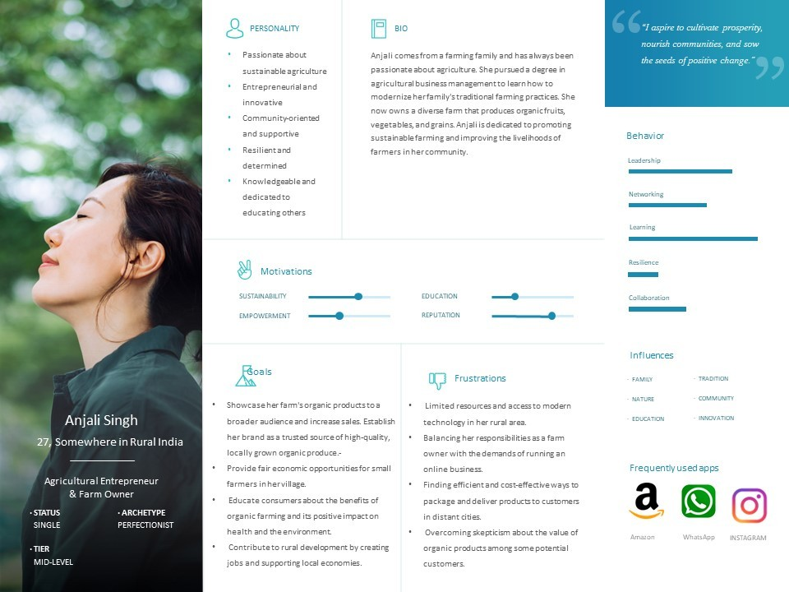
User Persona

Slide 13
User Roles
Distinct User Roles
AgriConnect Hub caters to various user roles, each with specific functionalities and privileges.
1. Farmers
Farmers can create profiles, list their products, and manage their inventory.
They interact with entrepreneurs and consumers directly.
2. Entrepreneurs
Entrepreneurs can explore listed products, place orders, and initiate transactions.
They contribute to local value-added ventures and rural economic growth.
3. Administrators
Administrators oversee the platform's operation, ensuring smooth functionality.
They manage user accounts, resolve issues, and ensure compliance.

Slide 14
Our Vision
Our Vision: Empowering Rural Entrepreneurship
Transforming rural landscapes through technology and collaboration.
Fostering economic growth, innovation, and community prosperity.
Local Impact, Global Change
Empowering farmers and entrepreneurs for lasting positive change.
Redefining rural entrepreneurship on a broader scale.
Join Us in Making a Difference
Your involvement fuels our vision's journey.
Together, we shape a future of rural empowerment.

Slide 15

Thank You for your valuable time.

